Slide 1

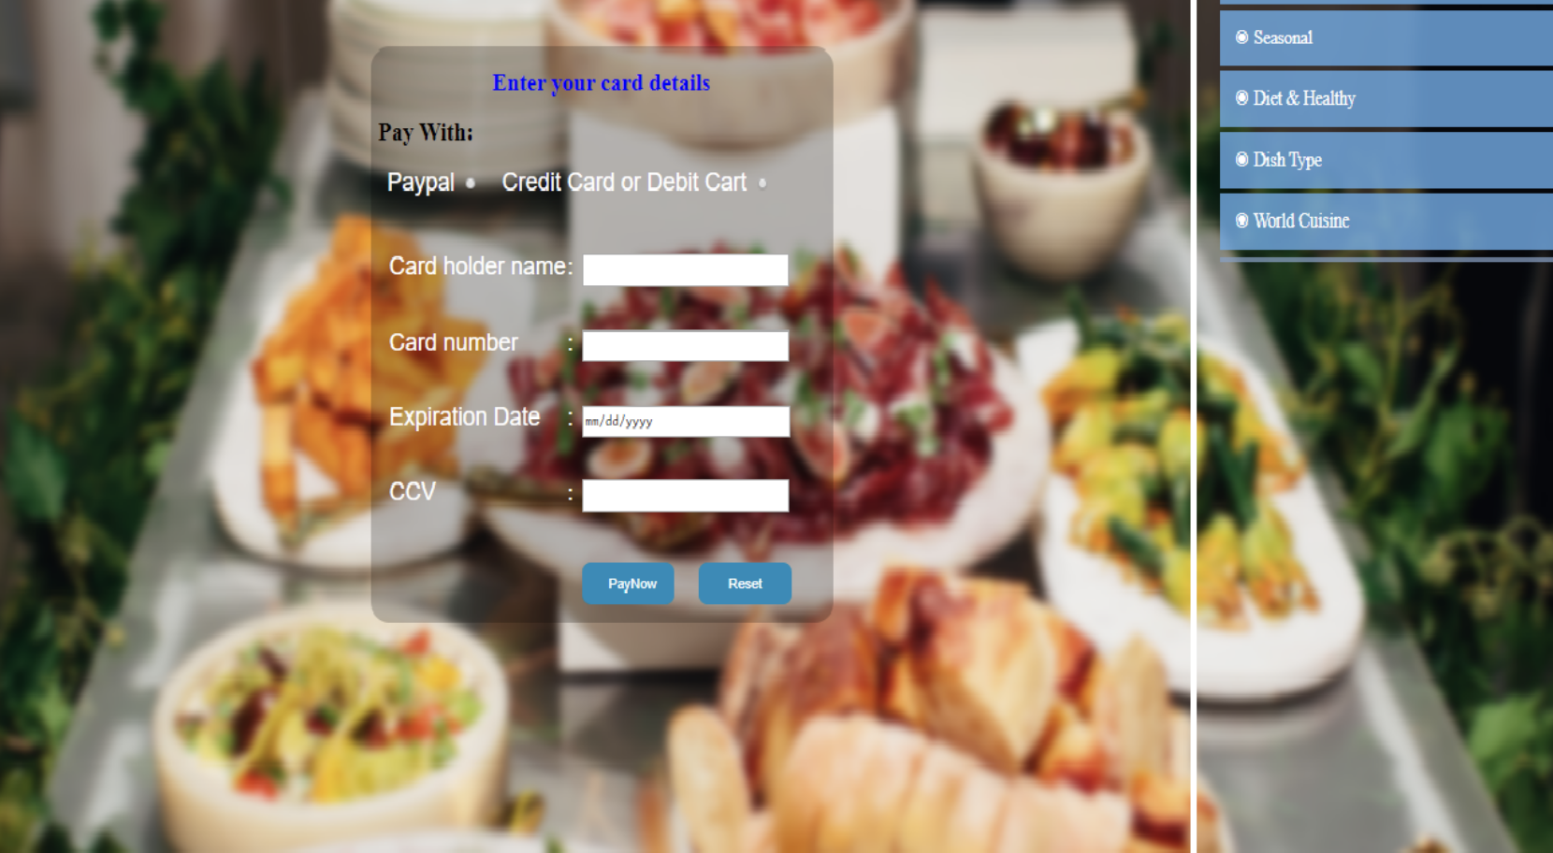
DESIGN AND DEVELOPMENT OF SMART RECIPE MANAGEMENT
AND RECOMMENDATION SYSTEM DATABASE
presented by:
Janani .R (192511067)
Bavani .S (192511146)
Harini . S (192511153)
Notes:
1

Slide 2
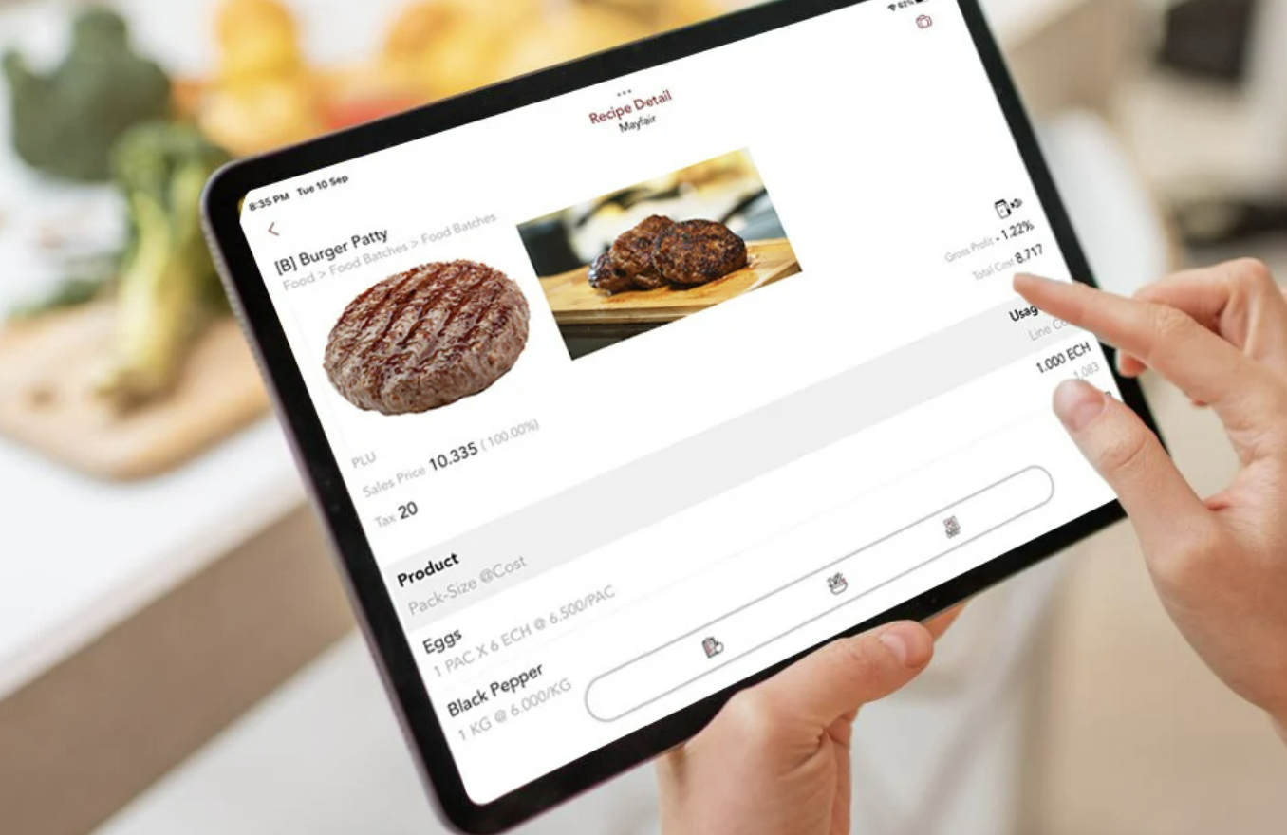
wwww
Project Objective –Database Driven System
Seamless Recipe Management
Enable users to easily read , update and search recipe in a centralized database
Efficient ingredient & meal planning
Help users plan meals efficiently by managing ingredients, reducing food waste and saving time.
Smart user experience
Offer a user friendly interface with intelligent filtering, rating and feedback to improve accuracy
Notes:
2

Slide 3

Module 1- Query Challenges
1
Users vs saved recipes:
Find users who save more recipes than an average user.
2
Recipes with above-average ratings
Recipes whose average rating is above the overall average.
3
Cuisines with more recipes than average
Cuisine types having more recipes than the average cuisine.
4
User Feedback Analysis
Users and their top-rated recipes above their own average rating.
Notes:
3

Slide 4
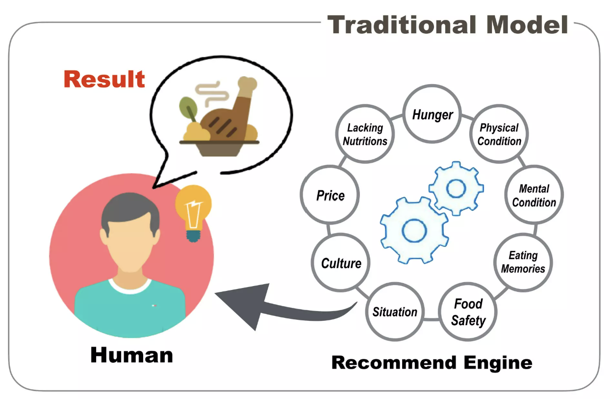



Module 2-Subqueries & Joins
Recipes vs. Average Rating
Use subqueries and joins to compare recipe ratings with the overall average rating.
User Activity: Above Average
Join users and saved recipes to find users whose saved recipe count exceeds the average.
Calorie-Based Recipe Analysis
Use joins to calculate total recipe calories and compare them with the average calorie value.
Notes:
4

Slide 5
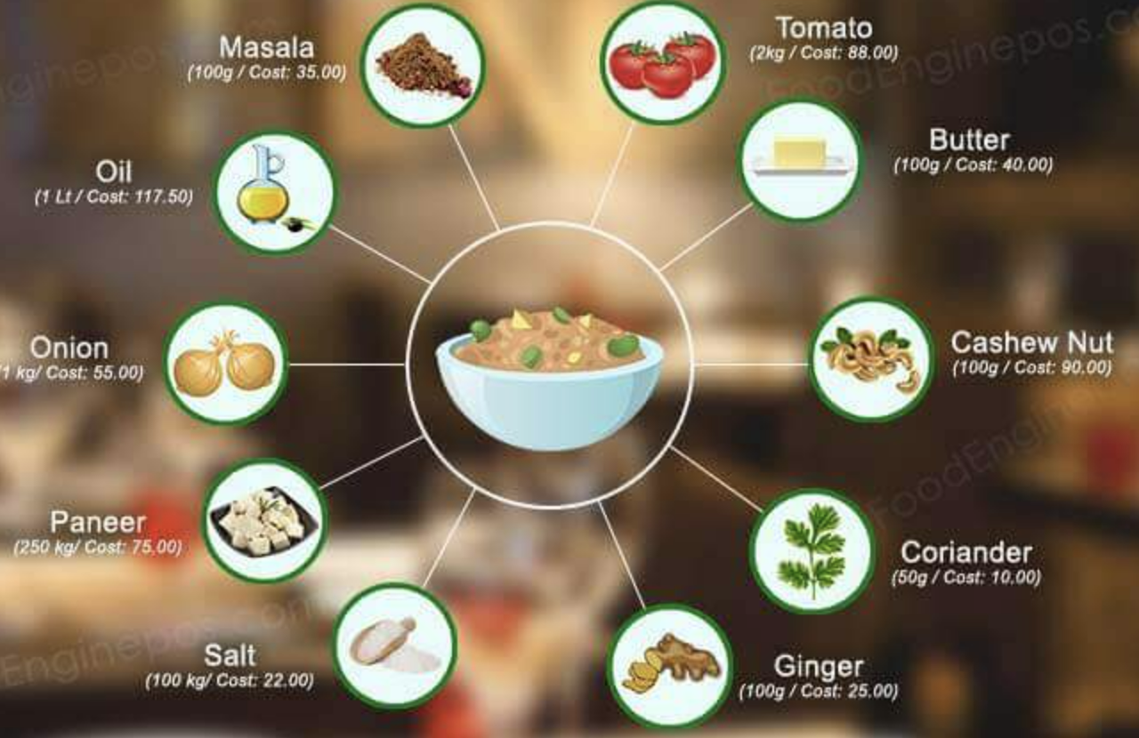
Applications of the System
Cooking and food recommendation apps
Nutrition and calorie tracking platforms
Restaurant menu management systems
Smart kitchen applications
Future Enhancements
The system can be enhanced by integrating advanced analytics and optimized SQL queries to provide more accurate and personalized recommendations as the database grows.
Notes:
5

Slide 6

Problem statement
Managing recipes, ingredients, and user data becomes difficult without a proper database structure.
This leads to data redundancy and inefficient data handling..
Existing recipe systems do not provide personalized recommendations based on user preferences.
User ratings and saved recipes are not effectively analyzed..
Calculating total calories and ingredient usage for recipes is complex in unorganized systems.
Nutritional analysis becomes time-consuming and inaccurate..
.
Notes:
8

Slide 7
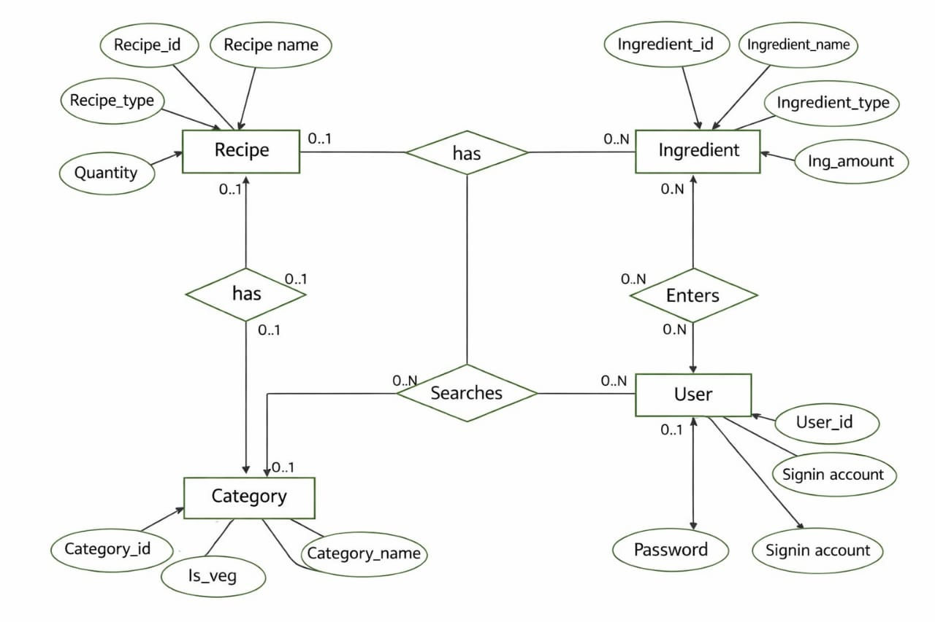
ER diagram for smart recipe management and recommendation system database

Slide 8
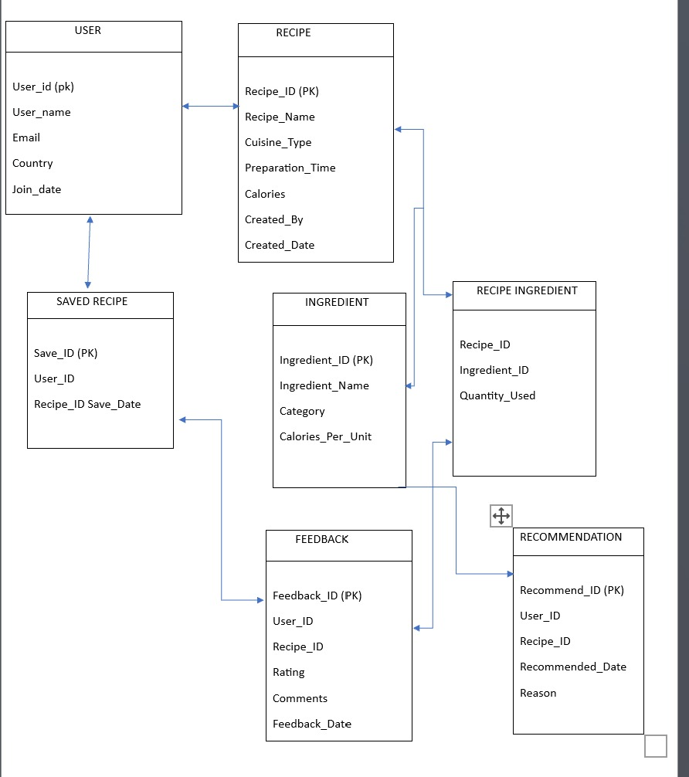
SCHEMA DIAGRAM for smart recipe management and recommendation system database

Slide 9
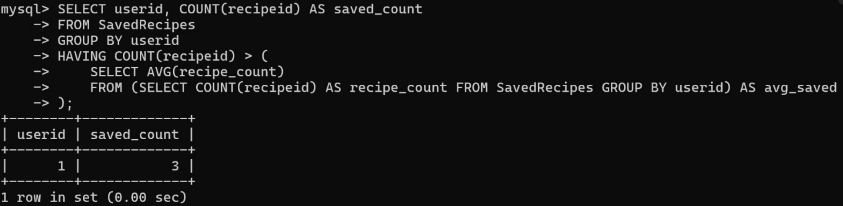
a. Find users who have saved more recipes than the average number of recipes saved by all users.
INPUT:
OUTPUT:
SELECT userid, COUNT(recipeid) AS
saved_count FROM SavedRecipes
GROUP BY userid
HAVING COUNT(recipeid) > (SELECT AVG(recipe_count)
FROM (SELECT COUNT(recipeid)
AS recipe_count
FROM SavedRecipes
GROUP BY userid)
AS avg_saved);
DESCRIPTION: Here the Query finds users who have saved more recipes than the average number

Slide 10
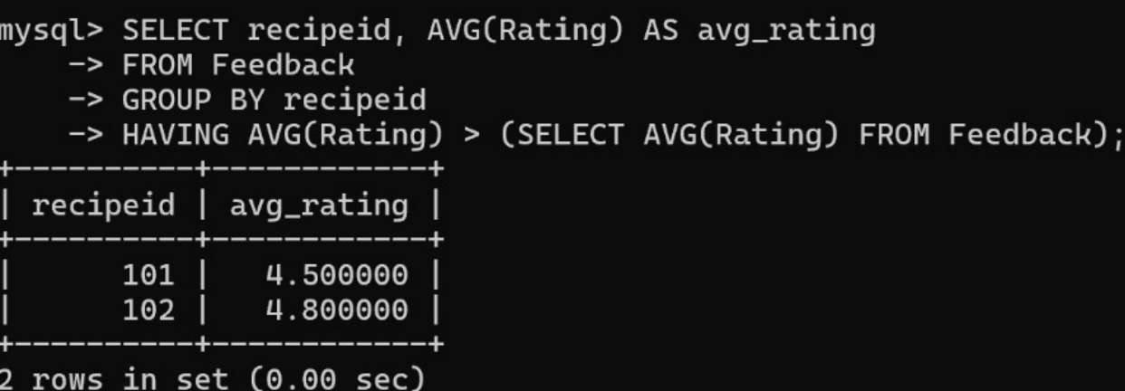
b. The query finds recipes that have an average rating above the overall average rating of all recipes.
INPUT:
OUTPUT:
SELECT recipeid,
AVG(Rating) AS avg_rating
FROM Feedback
GROUP BY recipeid
HAVING AVG(Rating) >
(SELECT AVG(Rating)
FROM Feedback);
DESCRIPTION: Here the Query finds recipes that have an average rating above the overall average rating of all recipes.

Slide 11
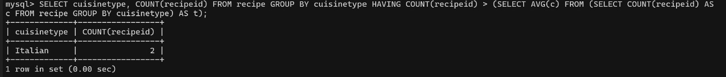
c. Identify cuisines that have more than the average number of recipes across all cuisine types
INPUT:
OUTPUT:
SELECT Cuisine_Type,
COUNT(Recipe_ID)FROM Recipe
GROUP BY
Cuisine_TypeHAVING COUNT
(Recipe_ID) >
( SELECT AVG(cuisine_count)
FROM (SELECT COUNT(Recipe_ID)
as cuisine_count FROM
Recipe GROUP BY
Cuisine_Type) as AvgCuisine);
DESCRIPTION: Here in this Query shows cuisine types that are more popular or frequently available .

Slide 12
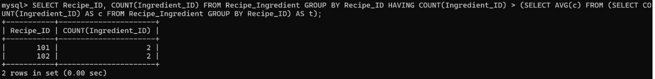
d. List recipes and their ingredient details where the recipe contains more ingredients than the average recipe.
INPUT:
OUTPUT:
SELECT Recipe_ID, COUNT
(Ingredient_ID)
FROM Recipe_Ingredient
GROUP BY Recipe_ID
HAVING COUNT(Ingredient_ID) > (
SELECT AVG(ing_count)
FROM (SELECT COUNT(Ingredient_ID) as c FROM Recipe_Ingredient GROUP BY Recipe_ID) as t
);
DESCRIPTION: Here the Query shows recipe with more ingredients than the average recipe.

Slide 13
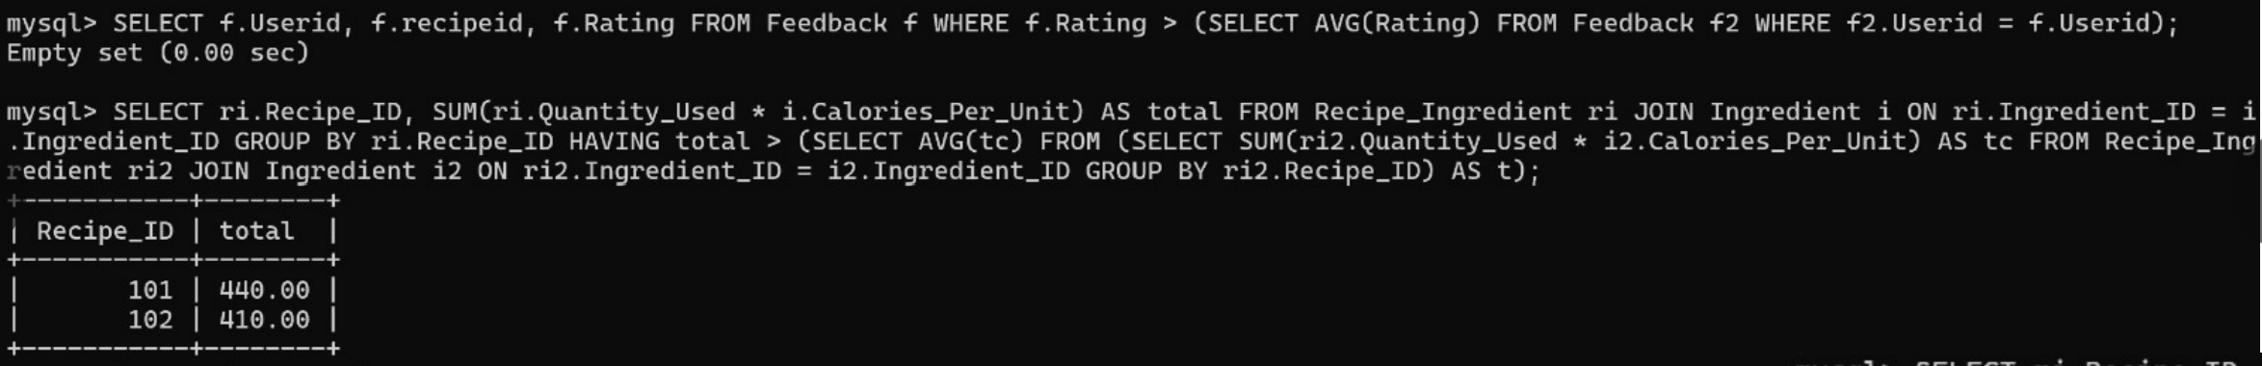
e.Find recipes with total calorie count higher than the average average calorie count per recipe using a join between recipe ingredient and ingredient.
INPUT:
OUTPUT:
SELECT ri.Recipe_ID,
SUM(ri.Quantity_Used * i.Calories_Per_Unit)
AS total FROM Recipe_Ingredient ri
JOIN Ingredient i ON
ri.Ingredient_ID = i.Ingredient_ID
GROUP BY ri.Recipe_ID
HAVING total > (SELECT AVG(tc)
FROM (SELECT SUM(ri2.Quantity_Used * i2.Calories_Per_Unit) AS tc FROM Recipe_Ingredient ri2 JOIN Ingredient i2 ON ri2.Ingredient_ID = i2.Ingredient_ID GROUP BY ri2.Recipe_ID) AS t);
DESCRIPTION: Here in this Query shows calorie count higher than the average average calorie count per recipe using a join between recipe ingredient and ingredient

Slide 14
CONCLUSION
The system efficiently manages and stores recipe data in a well-structured database.
It provides personalized recipe recommendations based on user preferences.
Proper database design reduces redundancy and ensures data consistency.
Overall, it enhances user experience by making recipe search and selection easier and faster.

Slide 15
𝐓𝐡𝐚𝐧𝐤 𝐘𝐨𝐮

